Slide 1




Financial inclusion in Africa

Slide 2

Problem Statement
AIM
Financial Inclusion
Bank Account
Savings
Insurance
Cheaper Credit
Transfer of Funds

Slide 3



Methodology
Data Preprocessing - clean, format, and restructure data
Splitting the Data into Training and Test Sets - 70% of the data will be used for training and 30% for testing
Evaluating Model Performance – investigate different models and determine which is best

Slide 4
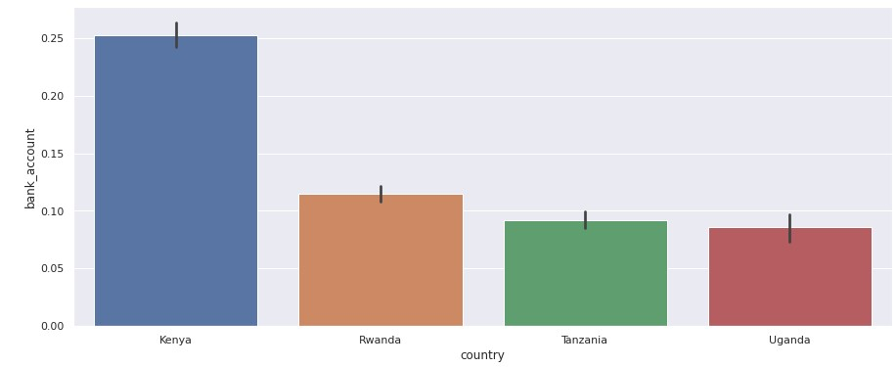
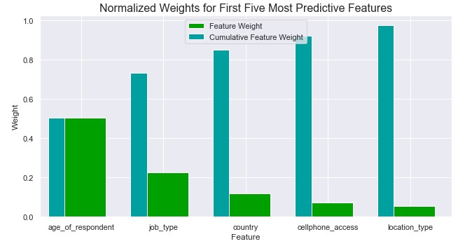
solutions
Logistic Regression – 85.74%
Random Forest – 85.39%
KNN – 86.59%

Slide 5
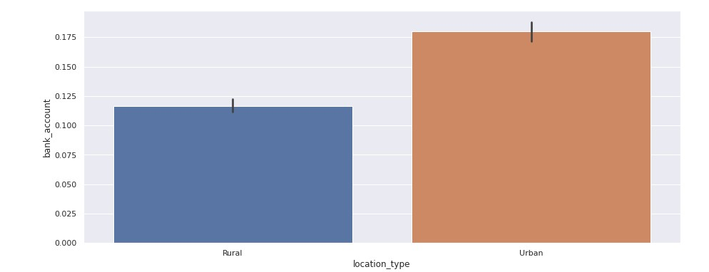
Impact
We suggest that African countries improve socio-economic factors pertaining to this variables to increase financial inclusion

Slide 6

Presenter – Nomfundo Mnguni
Tshepo Lesole
Sanele Thethwayo
Thobelani Mkhize
Khayelihle Biyela
Bona Dlamini
Mduduzi Mcobothi
Jimmy Olwethu
Ntuthuko Madondo
Philani Mdlalose
Sheshani Ngubane
Sizophila Ngcobo

